Slide 1

SOKOINE UNIVERSITY OF AGRICULTURE
School of Engineering and Technology | Department of Agricultural Engineering
AEN 214: INTRODUCTION TO ELECTRONICS — LECTURE 1
Passive Electronic Components
Resistors, Capacitors, Inductors & AC Reactance in Agricultural Instrumentation
Course Instructor: Dr. Kadeghe Goodluck Fue, PhD, P.Eng (T)
Electronics & Precision Agriculture Laboratory | Academic Year 2025/2026 | Sokoine University of Agriculture
Sokoine University of Agriculture | School of Engineering & Technology | Department of Agricultural Engineering
Slide 1 of 26

Slide 2
AEN 214: INTRODUCTION TO ELECTRONICS
Lecture 1 Learning Outcomes & Session Roadmap
• Decode Resistor Specifications: Read 4-band and 5-band color codes, EIA-96 SMD markings, tolerances, and power ratings.
• Evaluate Specialized Transducers: Understand thermistors (NTC/PTC), LDRs, strain gauges, and varistors in agricultural sensing.
• Analyze Capacitive Energy Storage: Calculate capacitance, electric fields, dielectric breakdown, and electrolytic polarity.
• Model RC Transient Dynamics: Solve differential charging and discharging equations and determine time constant tau = RC.
• Understand Electromagnetic Induction: Apply Faraday's and Lenz's laws to inductors, chokes, and energy storage.
• Prevent Inductive Transients: Mitigate relay/solenoid inductive kickback using freewheeling flyback diodes.
• Calculate AC Reactance & Resonance: Determine X_C, X_L, cutoff frequencies, and resonant LC tank parameters.
Sokoine University of Agriculture | School of Engineering & Technology | Department of Agricultural Engineering
Slide 2 of 26

Slide 3
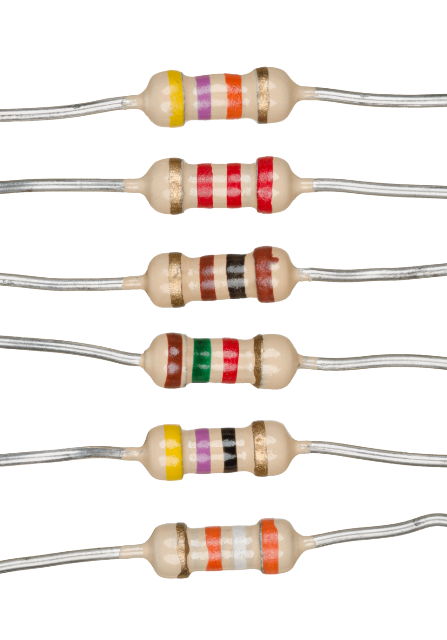
AEN 214: INTRODUCTION TO ELECTRONICS
Passive Components in Tanzanian AgriTech Systems
• Foundational Hardware Layer: Every tractor ECU, solar inverter, and automated greenhouse relies on passive components.
• Extreme Agro-Climatic Stress: In Morogoro, Dodoma, and Arusha, components face ambient heat (45°C), high humidity, and red dust.
• Sensor Interfacing: Passive resistor dividers convert high-impedance soil moisture and temperature signals for microcontrollers.
• Power Quality Filtering: Heavy irrigation pumps and diesel generators induce voltage sags and spikes that require LC filter stages.
• Economic Reliability: Selecting inadequate resistor power ratings or low-voltage capacitors causes catastrophic farm equipment fires.
Sokoine University of Agriculture | School of Engineering & Technology | Department of Agricultural Engineering
Slide 3 of 26

Slide 4
AEN 214: INTRODUCTION TO ELECTRONICS
Resistor Fundamentals: Conduction & Ohm's Law
• Governing Equation: Ohm's Law states V = I · R; Electric current is directly proportional to applied voltage.
• Physical Resistance Equation: R = rho · (L / A), where rho is resistivity (Ohm-m), L is conductor length, and A is cross-sectional area.
• Temperature Dependence: R(T) = R_0 [1 + alpha · (T - T_0)], where alpha is the Temperature Coefficient of Resistance (TCR).
• Conductor Materials: Copper has low resistivity (1.68 x 10^-8 Ohm-m); Nichrome alloy provides high resistance for heating elements.
• Power Dissipation: Electrical energy is converted to heat via Joule heating: P = I² · R = V² / R = V · I (Watts).
Sokoine University of Agriculture | School of Engineering & Technology | Department of Agricultural Engineering
Slide 4 of 26

Slide 5
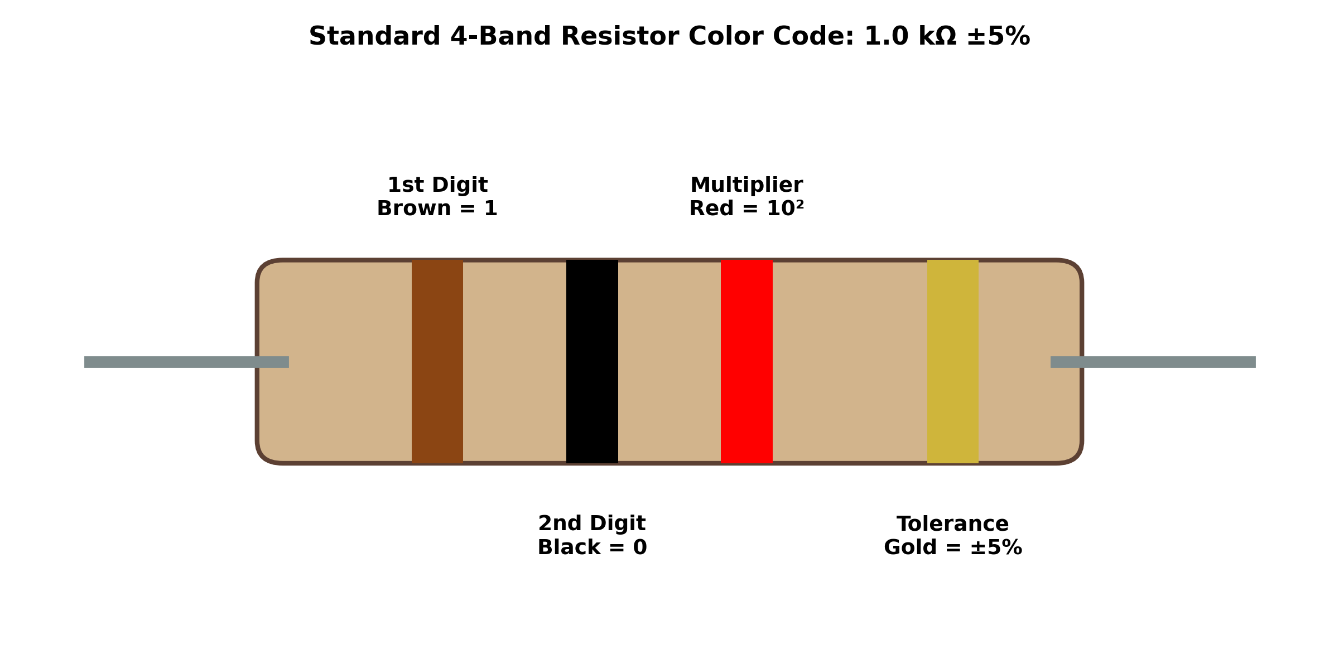
AEN 214: INTRODUCTION TO ELECTRONICS
Resistor Types & Physical Construction
• Carbon Film Resistors: General purpose, economical, moderate stability (±5% tolerance), suited for basic breadboarding.
• Metal Film Resistors: Nichrome deposited on ceramic rods; low noise, high precision (±0.1% to ±1%), essential for analog sensors.
• Wirewound Resistors: Manganin/Constantan wire wound on ceramic cores; high power (5W to 100W+), used in motor braking and heaters.
• Surface Mount Devices (SMD): Compact ceramic chip resistors (0805, 0603 packages) mounted in automated tractor GPS boards.
• High-Frequency Derating: Parasitic lead inductance (L_lead) and shunt capacitance (C_shunt) degrade high-frequency performance.
Sokoine University of Agriculture | School of Engineering & Technology | Department of Agricultural Engineering
Slide 5 of 26

Slide 6
AEN 214: INTRODUCTION TO ELECTRONICS
Standard Resistor Color Coding & Numerical Codes
• Standard 4-Band System: Band 1 (1st digit), Band 2 (2nd digit), Band 3 (Multiplier 10^n), Band 4 (Tolerance %: Gold=±5%, Silver=±10%).
• Precision 5-Band System: Bands 1, 2, 3 (Significant digits), Band 4 (Multiplier), Band 5 (Tolerance: Brown=±1%, Red=±2%).
• Mnemonic Memory Aid: Bad Boys Ring Our Young Girls But Violet Gives Willingly (Black, Brown, Red, Orange, Yellow, Green, Blue, Violet, Gray, White).
• SMD 3-Digit Code: '472' = 47 x 10² Ohm = 4.7 kOhm; '104' = 10 x 10⁴ Ohm = 100 kOhm; 'R' denotes decimal point: '4R7' = 4.7 Ohm.
• EIA-96 High-Precision System: Two-digit lookup code followed by an alphabetic multiplier letter (e.g. 01C = 10 kOhm ±1%).
Sokoine University of Agriculture | School of Engineering & Technology | Department of Agricultural Engineering
Slide 6 of 26

Slide 7
AEN 214: INTRODUCTION TO ELECTRONICS
Power Ratings & Agricultural Thermal Derating
• Standard Package Ratings: Through-hole resistors are rated at 0.125W (1/8W), 0.25W (1/4W), 0.5W (1/2W), 1.0W, 2.0W, and 5.0W+.
• Maximum Surface Temperature: Resistors reach 125°C to 155°C at full rated power; ambient air must carry away dissipated heat.
• Field Derating Rule: In tropical African agricultural environments (ambient > 40°C), derate rated power by 50% (P_safe <= 0.50 · P_rated).
• Component Spacing: Mount power resistors at least 5 mm above PCB substrate to avoid scorching fiberglass and adjacent traces.
• Flammability: Use flame-proof metal oxide resistors in poultry brooders to prevent fire ignition from accumulated flammable feathers.
Sokoine University of Agriculture | School of Engineering & Technology | Department of Agricultural Engineering
Slide 7 of 26

Slide 8
AEN 214: INTRODUCTION TO ELECTRONICS
Special Purpose Resistors in Agricultural Automation
• Negative Temperature Coefficient (NTC) Thermistors: Resistance drops non-linearly as temperature increases; monitors grain silos.
• Positive Temperature Coefficient (PTC) Thermistors: Self-resetting polymeric overcurrent fuses protecting DC pump motors.
• Light Dependent Resistors (LDRs): Cadmium Sulfide (CdS) photoconductive cells; resistance drops from 1 MOhm (dark) to 500 Ohm (sun).
• Piezoresistive Strain Gauges: Foil resistors that change value under strain (Delta R / R = G · epsilon); weigh livestock on dairy platforms.
• Metal Oxide Varistors (MOVs): Non-linear voltage-clamping zinc-oxide ceramic discs that suppress lightning surges on farm mains.
Sokoine University of Agriculture | School of Engineering & Technology | Department of Agricultural Engineering
Slide 8 of 26

Slide 9
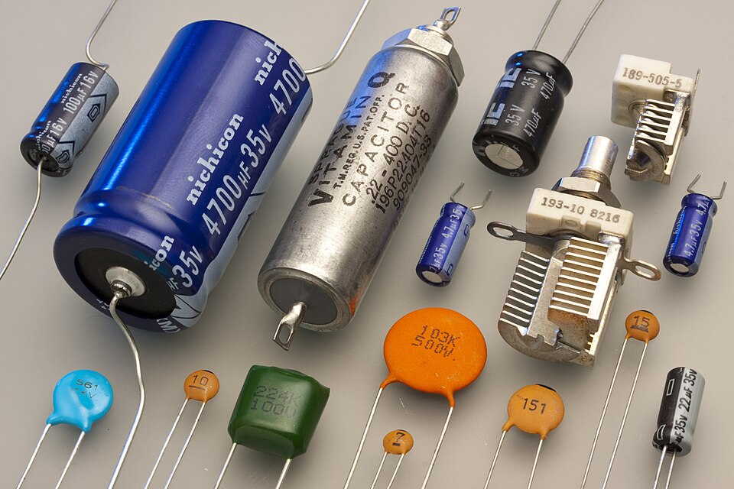
AEN 214: INTRODUCTION TO ELECTRONICS
Capacitors: Electrostatic Principles & Dielectrics
• Physical Structure: Two parallel conducting plates separated by an insulating dielectric medium.
• Capacitance Equation: C = (epsilon_r · epsilon_0 · A) / d, where epsilon_0 = 8.854 x 10^-12 F/m, and epsilon_r is relative permittivity.
• Charge-Voltage Law: Q = C · V; Charge stored Q (Coulombs) is proportional to terminal potential difference V (Volts).
• Electrostatic Energy: W = 0.5 · C · V² = 0.5 · (Q² / C); Stored in the polarized electric field of the dielectric.
• Dielectric Breakdown: Exceeding breakdown field strength (E_max = V_max / d) causes dielectric punch-through and short-circuit failure.
Sokoine University of Agriculture | School of Engineering & Technology | Department of Agricultural Engineering
Slide 9 of 26

Slide 10
AEN 214: INTRODUCTION TO ELECTRONICS
Capacitor Technologies & Non-Ideal Parasitics
• Ceramic Capacitors (Class 1 NP0/C0G): Extremely stable, ultra-low loss, zero DC bias effect; ideal for RF and precision timing.
• Ceramic Capacitors (Class 2 X7R, Y5V): High capacitance per volume; used for DC power rail decoupling near microcontrollers.
• Aluminum Electrolytic Capacitors: Liquid/gel electrolyte with thin Al2O3 oxide film; polarized; high capacitance for power smoothing.
• Film Capacitors (Polypropylene/Polyester): Low ESR and high AC ripple current capability; used across AC induction motor run windings.
• Equivalent Series Resistance (ESR): Internal ohmic loss; causes heating during high-frequency ripple currents in solar MPPT inverters.
Sokoine University of Agriculture | School of Engineering & Technology | Department of Agricultural Engineering
Slide 10 of 26

Slide 11
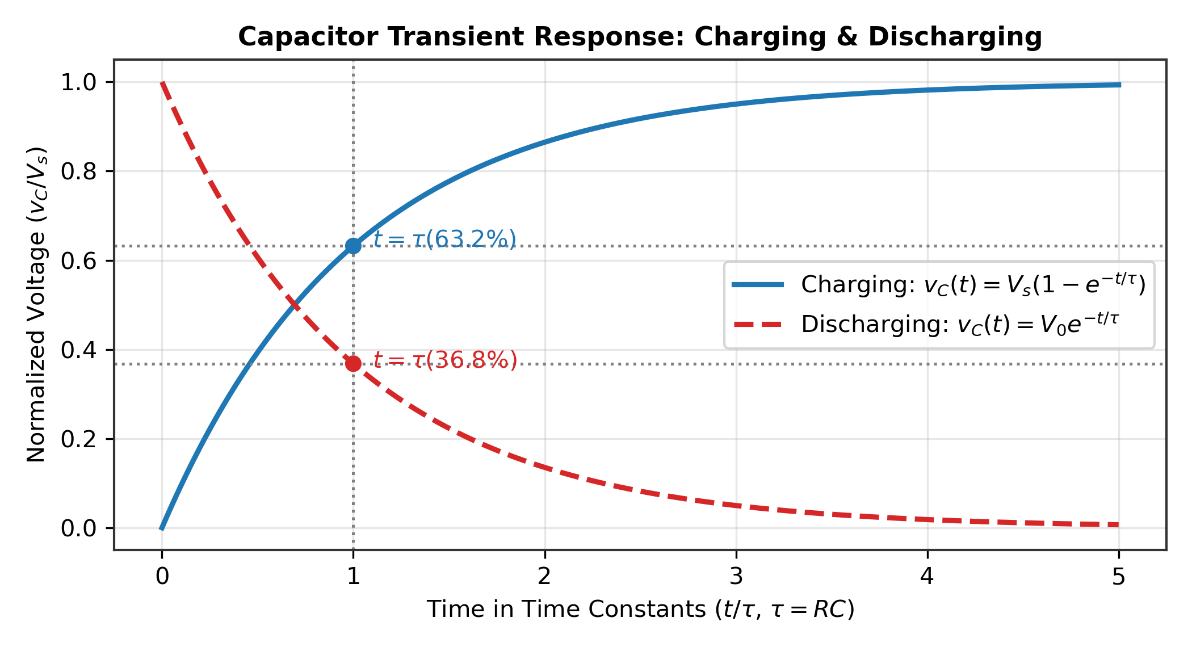
AEN 214: INTRODUCTION TO ELECTRONICS
RC Circuit Transient Analysis & Time Constant
• First-Order Differential Model: Kirchhoff's Loop Law: V_s = i(t) · R + v_C(t) = R · C · (dv_C / dt) + v_C(t).
• Charging Characteristic: v_C(t) = V_s · [1 - exp(-t / tau)], where time constant tau = R · C (seconds).
• Discharging Characteristic: v_C(t) = V_0 · exp(-t / tau), discharging stored energy into load resistor R.
• Transient Benchmarks: At t = 1 tau, capacitor reaches 63.2% of final voltage; at t = 5 tau, capacitor reaches 99.3% (steady state).
• Hardware Timer Applications: RC timing networks define delay intervals in irrigation solenoid pulsers and watchdog reset circuits.
Sokoine University of Agriculture | School of Engineering & Technology | Department of Agricultural Engineering
Slide 11 of 26

Slide 12
AEN 214: INTRODUCTION TO ELECTRONICS
Worked Engineering Example 1: Resistor Color Decoding & Thermal Derating
PROBLEM SPECIFICATION & AGRICULTURAL CONTEXT:
A precision sensor conditioning circuit for a soil moisture probe uses a 5-band resistor with bands: Orange (3), White (9), Black (0), Brown (x10), Brown (±1%). In continuous operation at Morogoro (ambient 42°C), it drops 15.0V. Calculate: (a) Nominal resistance and tolerance, (b) Power dissipated, (c) Minimum manufacturer wattage rating with a 50% safety factor.
STEP-BY-STEP MATHEMATICAL SOLUTION & VERIFICATION:
1. Decode Bands: Band 1=3, Band 2=9, Band 3=0 -> Digits '390'. Band 4 is multiplier: x10^1 = x10. Nominal R = 390 x 10 = 3,900 Ohm (3.9 kOhm).
2. Tolerance: Band 5 is Brown -> ±1% tolerance. Range = 3,900 ± 39 Ohm (3,861 Ohm to 3,939 Ohm).
3. Calculate Operating Power: P = V² / R = (15.0 V)² / 3,900 Ohm = 225 / 3,900 = 0.0577 W (57.7 mW).
4. Apply Field Derating Factor: Required Rating P_rated >= P_operating / 0.50 = 0.0577 W / 0.50 = 0.1154 W.
5. Commercial Selection: Standard 0.25 W (1/4 W) metal-film resistor provides generous safety margin and long-term stability.
Sokoine University of Agriculture | School of Engineering & Technology | Department of Agricultural Engineering
Slide 12 of 26

Slide 13
AEN 214: INTRODUCTION TO ELECTRONICS
Worked Engineering Example 2: RC Charging Transient in Drip Irrigation Controller
PROBLEM SPECIFICATION & AGRICULTURAL CONTEXT:
An automated drip irrigation pulse timer at Kilombero Sugar nursery uses an RC charging circuit with R = 470 kOhm and electrolytic capacitor C = 100 microFarad powered from a regulated V_s = 12.0 V solar battery rail. The Schmitt-trigger timer fires when v_C reaches 8.0 V. Determine: (a) Time constant tau, (b) Time delay t_fire to reach 8.0 V, (c) Energy stored in the capacitor at trigger.
STEP-BY-STEP MATHEMATICAL SOLUTION & VERIFICATION:
1. Time Constant Calculation: tau = R · C = (470 x 10^3 Ohm) · (100 x 10^-6 F) = 47.0 seconds.
2. Formulate Transient Equation: v_C(t) = V_s · [1 - exp(-t / tau)] -> 8.0 V = 12.0 V · [1 - exp(-t / 47.0)].
3. Solve for Exponential Term: 1 - exp(-t / 47.0) = 8.0 / 12.0 = 0.6667 -> exp(-t / 47.0) = 0.3333.
4. Invert via Natural Logarithm: -t / 47.0 = ln(0.3333) = -1.0986 -> t_fire = 47.0 · 1.0986 = 51.63 seconds.
5. Stored Electrostatic Energy: W = 0.5 · C · V² = 0.5 · (100 x 10^-6 F) · (8.0 V)² = 0.5 · 10^-4 · 64 = 3.20 mJ.
Sokoine University of Agriculture | School of Engineering & Technology | Department of Agricultural Engineering
Slide 13 of 26

Slide 14
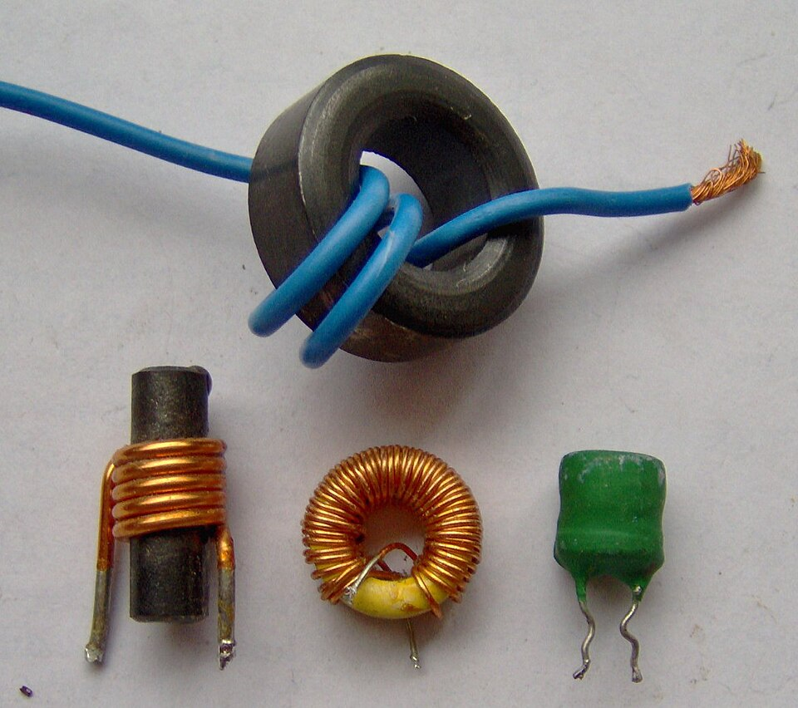
AEN 214: INTRODUCTION TO ELECTRONICS
Inductors: Magnetic Physics & Faraday's Law
• Self-Inductance Equation: L = (mu_r · mu_0 · N² · A) / l, where N is turn count, A is core area, and l is magnetic path length.
• Faraday-Lenz Law: Terminal induced EMF opposes rate of change of current: v_L(t) = L · (di / dt).
• Magnetic Energy Storage: Stored magnetic field energy W = 0.5 · L · I² (Joules).
• Core Types: Air core (zero saturation, low inductance), Ferrite core (high frequency, switch-mode power), Laminated iron (50 Hz mains).
• Current Continuity Rule: Current through an inductor cannot change instantaneously (Delta I / Delta t < infinity).
Sokoine University of Agriculture | School of Engineering & Technology | Department of Agricultural Engineering
Slide 14 of 26

Slide 15
AEN 214: INTRODUCTION TO ELECTRONICS
The Inductive Kickback Hazard in Farm Actuators
• The Kickback Phenomenon: Abruptly opening a switch driving a relay, hydraulic valve, or solenoid forces di/dt to large negative values.
• Transient Voltage Spike: v_spike = -L · (di/dt) can generate reverse surges of 200V to 1,500V across open contacts or switching transistors.
• Component Destruction: Causes dielectric arcing across relay contacts, transistor collector punch-through, and microchip latchup.
• Flyback Diode Clamping: Connect a fast rectifier diode (e.g. 1N4007 or UF4007) in anti-parallel across the inductive solenoid coil.
• Conduction Mechanism: When the switch opens, coil current circulates safely through the forward-biased flyback diode until dissipated.
Sokoine University of Agriculture | School of Engineering & Technology | Department of Agricultural Engineering
Slide 15 of 26

Slide 16
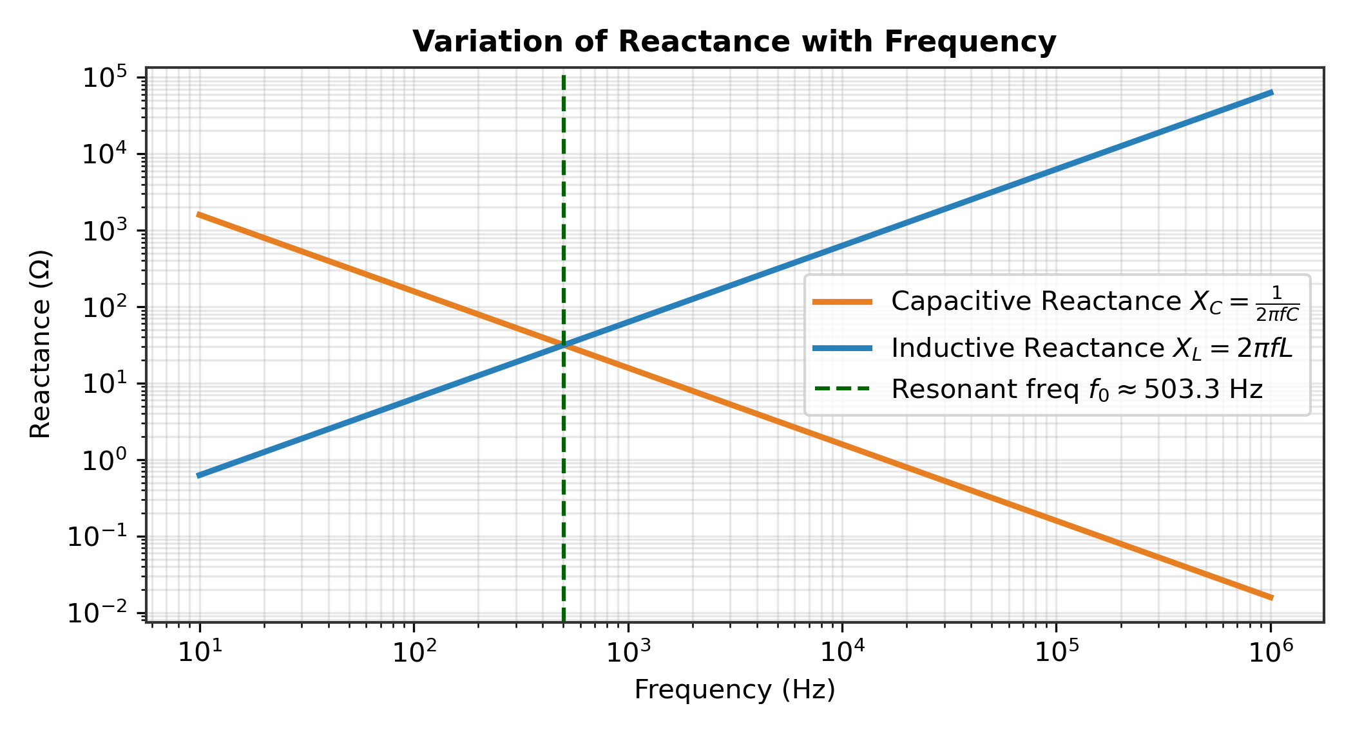
AEN 214: INTRODUCTION TO ELECTRONICS
Capacitive & Inductive Reactance in AC Circuits
• Capacitive Reactance: X_C = 1 / (2 · pi · f · C) (Ohms); Inversely proportional to frequency (blocks DC, passes AC high frequencies).
• Inductive Reactance: X_L = 2 · pi · f · L (Ohms); Directly proportional to frequency (passes DC, blocks high-frequency electrical noise).
• Phase Relationships: In a pure capacitor, current leads voltage by 90° ('ICE'); in an inductor, voltage leads current by 90° ('ELI').
• Complex Impedance: Z_total = R + j(X_L - X_C); Magnitude |Z| = sqrt[ R² + (X_L - X_C)² ], Phase theta = arctan[(X_L - X_C) / R].
• Series Resonance Condition: When X_L = X_C, reactance cancels, impedance drops to pure resistance R, and current reaches maximum.
Sokoine University of Agriculture | School of Engineering & Technology | Department of Agricultural Engineering
Slide 16 of 26

Slide 17
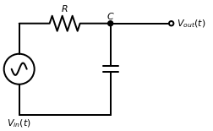
AEN 214: INTRODUCTION TO ELECTRONICS
Passive RC & LC Filter Topologies for Agro-Sensors
• Low-Pass RC Filter: Series resistor R and shunt capacitor C; Cutoff frequency f_c = 1 / (2 · pi · R · C).
• Agricultural Noise Suppression: Low-pass filters strip 50 Hz power hum and alternator hash from analog pH and moisture probes.
• High-Pass RC Filter: Series capacitor C and shunt resistor R; blocks DC drift while passing fast transient acoustic emission pulses.
• LC Band-Pass Tank: Combines parallel inductor and capacitor; tunes to specific carrier frequencies in livestock RFID telemetry.
• Insertion Loss & Roll-off: Single-stage passive RC filter attenuates at -20 dB/decade (-6 dB/octave) above corner frequency f_c.
Sokoine University of Agriculture | School of Engineering & Technology | Department of Agricultural Engineering
Slide 17 of 26

Slide 18
AEN 214: INTRODUCTION TO ELECTRONICS
Worked Engineering Example 3: LC Tank Resonance for Livestock RFID Tag
PROBLEM SPECIFICATION & AGRICULTURAL CONTEXT:
An automated cattle gate RFID transceiver operating under ISO 11784/11785 standards requires an LC resonant tank tuned precisely to carrier frequency f_0 = 134.2 kHz. The antenna coil has an inductance L = 470 microHenry. Calculate: (a) Tuning capacitance C required, (b) Inductive reactance X_L at resonance, (c) Tank quality factor Q if coil series resistance R = 4.2 Ohm.
STEP-BY-STEP MATHEMATICAL SOLUTION & VERIFICATION:
1. Resonance Formula: f_0 = 1 / [2 · pi · sqrt(L · C)] -> sqrt(L · C) = 1 / [2 · pi · f_0].
2. Square Both Sides: L · C = 1 / [4 · pi² · f_0²] -> C = 1 / [4 · pi² · f_0² · L].
3. Substitute Parameters: f_0 = 134,200 Hz; L = 470 x 10^-6 H. Calculate: 4 · pi² · (134,200)² = 7.108 x 10^11 s^-2.
Denom = 7.108 x 10^11 · 470 x 10^-6 = 3.341 x 10^8 -> C = 1 / 3.341 x 10^8 = 2.993 x 10^-9 F = 2.99 nF (use 3.0 nF).
4. Reactance at Resonance: X_L = 2 · pi · (134,200 Hz) · (470 x 10^-6 H) = 396.3 Ohm.
5. Quality Factor Calculation: Q = X_L / R = 396.3 Ohm / 4.2 Ohm = 94.36 (High Q provides excellent RFID reading distance).
Sokoine University of Agriculture | School of Engineering & Technology | Department of Agricultural Engineering
Slide 18 of 26

Slide 19
AEN 214: INTRODUCTION TO ELECTRONICS
Environmental Protection for Farm Passive Components
• Tropical Humidity & Condensation: Moisture creates ionic leakage paths between high-impedance resistor traces; conformal coating required.
• Corrosive Fertilizer & Ammonia Gas: In poultry houses and pig barns, sulfur and ammonia corrode copper leads; use hermetic seals.
• Tractor Chassis Mechanical Shock: Engine vibration fractures brittle ceramic chip capacitors; specify automotive AEC-Q200 components.
• Thermal Expansion Stress: Solar sensor junction boxes cycle from 15°C (night) to 65°C (noon); differential expansion causes solder cracking.
• Lightning & Mains Surges: Rural Tanzanian distribution grids experience frequent inductive spikes; MOV and gas discharge tubes are mandatory.
Sokoine University of Agriculture | School of Engineering & Technology | Department of Agricultural Engineering
Slide 19 of 26

Slide 20
AEN 214: INTRODUCTION TO ELECTRONICS
Tanzanian Field Case Study 1: Flyback Clamping in Sugarcane Solenoid Valve Bank
FIELD LOCATION & PROBLEM IDENTIFICATION
• Geographic Location: Kilombero Sugar Company, Morogoro Region, Tanzania
A multi-zone hydraulic valve manifold controlling automatic sugarcane cutter height experienced recurrent MOSFET switch failures. Every 3 days, a driver transistor failed short-circuit, dumping hydraulic fluid and idling cane harvesters during peak harvesting campaign.
SUA ENGINEERING SOLUTION & AGRONOMIC IMPACT
SUA agricultural engineers inspected the failed driver PCB and discovered that the 24V, 1.8A hydraulic solenoids lacked flyback diode protection. Oscilloscope monitoring captured negative inductive kickback voltage spikes exceeding -480V at valve de-energization, puncturing transistor junctions. Fast-recovery BYV26E avalanche diodes were installed directly across each solenoid coil terminal with anti-vibration potting.
Measurable Performance Metrics:
✔ Eliminated 100% of driver transistor electrical failures across the entire milling season.
✔ Saved an estimated 14,000 USD in downtime and replacement electronics.
✔ Valve de-activation response stabilized within 12 ms without hydraulic hammer.
Sokoine University of Agriculture | School of Engineering & Technology | Department of Agricultural Engineering
Slide 20 of 26

Slide 21
AEN 214: INTRODUCTION TO ELECTRONICS
Tanzanian Field Case Study 2: Passive RC Filtering for Paddy Soil Salinity Sensor
FIELD LOCATION & PROBLEM IDENTIFICATION
• Geographic Location: Mbarali Rice Irrigation Scheme, Mbeya Region, Tanzania
Precision agricultural sensors measuring soil electrical conductivity (EC) in flooded paddy fields produced erratic telemetry readings. High 50 Hz powerline hum and switching noise from adjacent 45 kW electric pumping stations coupled into the long buried transducer cables, causing false salinity alarms.
SUA ENGINEERING SOLUTION & AGRONOMIC IMPACT
Engineers designed a balanced 2nd-order passive RC low-pass filter with corner frequency f_c = 15 Hz (R = 10 kOhm, C = 1 microFarad polypropylene film capacitor). A high-impedance buffer shielded the sensor from capacitive loading. The passive filter attenuated high-frequency generator interference by 42 dB while preserving valid agricultural soil dynamics.
Measurable Performance Metrics:
✔ Measurement noise reduced from ±18.4% down to ±0.8% of full-scale reading.
✔ Enabled reliable automated variable-rate flush irrigation in saline paddy plots.
✔ 100% passive design operating maintenance-free without external battery draw.
Sokoine University of Agriculture | School of Engineering & Technology | Department of Agricultural Engineering
Slide 21 of 26

Slide 22
AEN 214: INTRODUCTION TO ELECTRONICS
Laboratory Bench Protocol: Bench Prototyping & Diagnostic Protocol for Passives
PRACTICAL LAB LEARNING OUTCOMES & BENCH REQUIREMENTS:
• Master resistance measurement using 4-wire Kelvin probes and decode unknown color-band resistors.
• Capture capacitor charge/discharge exponential curves on digital storage oscilloscope (DSO).
• Verify RC time constant tau and measure AC filter cutoff frequency (-3 dB point).
• Observe inductive kickback pulse and verify flyback diode voltage clamping.
STEP-BY-STEP PROTOTYPING & DIAGNOSTIC PROCEDURE:
Step 1: Inspect 10 assorted resistors; record nominal color code value, tolerance, and measured DMM resistance.
Step 2: Assemble RC circuit (R = 100 kOhm, C = 47 microFarad) on breadboard. Connect DSO Channel 1 across capacitor.
Step 3: Apply 10V step input; trigger DSO; measure 10% to 90% rise time and verify empirical tau against tau = R · C.
Step 4: Connect 12V relay coil to bench DC supply through manual pushbutton switch. Probe coil voltage with 10x DSO probe.
Step 5: Release pushbutton; capture inductive kickback spike amplitude (> 200V). Solder 1N4007 diode; repeat and observe clamped 0.7V drop.
Sokoine University of Agriculture | School of Engineering & Technology | Department of Agricultural Engineering
Slide 22 of 26

Slide 23
AEN 214: INTRODUCTION TO ELECTRONICS
Diagnostic Troubleshooting & Common Component Failures
• Open-Circuit Resistor: Overheated carbon resistors drift high in value or fail open; visual blistering or black discoloration.
• Electrolytic Capacitor Degradation: Electrolyte dries out in hot climates, causing capacitance drop and soaring ESR (causes hum).
• Reversed Electrolytic Polarity: Reverse DC voltage generates internal hydrogen gas; catastrophic casing rupture and safety vent blowout.
• Shorted Ceramic Capacitor: Mechanical bending stress cracks multilayer ceramic capacitors (MLCC), creating low-resistance shorts.
• Inductor Core Saturation: Excessive DC bias current pushes ferrite core into saturation; inductance collapses, causing overcurrent.
Sokoine University of Agriculture | School of Engineering & Technology | Department of Agricultural Engineering
Slide 23 of 26

Slide 24
AEN 214: INTRODUCTION TO ELECTRONICS
Lecture 1 Self-Assessment & Upcoming Topics
SELF-ASSESSMENT & PROBLEM-SOLVING EXERCISES:
Q: A 4-band resistor has bands Yellow, Violet, Orange, Gold. What is its nominal resistance and acceptable manufacturing range?
Q: Why must an electrolytic capacitor never be connected with reverse polarity in an agricultural DC power supply?
Q: Derive the formula for time constant tau of a series RC circuit and prove that at t = tau, the capacitor charges to 63.2%.
Q: Explain the physical origin of inductive kickback in a solenoid valve and draw the schematic of a flyback protection diode.
Q: Calculate the cutoff frequency of a passive low-pass RC filter with R = 3.3 kOhm and C = 0.1 microFarad.
NEXT LECTURE PREVIEW & REQUIRED PREPARATION:
Lecture 2 will explore Semiconductor Physics: Bohr's atomic model, silicon energy bands, intrinsic vs extrinsic doping, and PN junction kinetics.
Sokoine University of Agriculture | School of Engineering & Technology | Department of Agricultural Engineering
Slide 24 of 26

Slide 25
AEN 214: INTRODUCTION TO ELECTRONICS
Lecture 1 Synthesis: Key Takeaways & Formula Sheet
CORE CONCEPTUAL TAKEAWAYS
✔ Passive components (R, L, C) form the bedrock of all analog and digital agricultural electronic systems.
✔ Resistor power ratings must be derated by 50% in tropical Tanzanian operating environments.
✔ Capacitor charge/discharge dynamics follow first-order exponential curves defined by tau = R · C.
✔ Inductive kickback poses severe hazards to semiconductor switches and requires mandatory flyback diodes.
✔ AC reactance is frequency-dependent: Capacitors block DC (X_C -> inf), while inductors block high frequencies (X_L = 2*pi*f*L).
CRITICAL ENGINEERING FORMULAS
★ Ohm's Law: V = I · R; Power: P = I²R = V²/R
★ Physical Resistance: R = rho · (L / A)
★ Capacitance: C = (eps_r · eps_0 · A) / d; Q = C · V
★ RC Charging: v_C(t) = V_s · [1 - exp(-t / RC)]
★ Inductor Voltage: v_L(t) = L · (di / dt); W = 0.5 · L · I²
★ Reactance: X_C = 1 / (2*pi*f*C); X_L = 2*pi*f*L
★ Resonant Frequency: f_0 = 1 / [2*pi*sqrt(L*C)]
Sokoine University of Agriculture | School of Engineering & Technology | Department of Agricultural Engineering
Slide 25 of 26

Slide 26
AEN 214: INTRODUCTION TO ELECTRONICS
Prescribed References & Practical Laboratory Preparation
• Boylestad, R. L., & Nashelsky, L. (2018). Electronic Devices and Circuit Theory (11th ed.). Pearson Education.
• Sedra, A. S., & Smith, K. C. (2020). Microelectronic Circuits (8th ed.). Oxford University Press.
• Floyd, T. L. (2017). Electronic Devices: Conventional Current Version (10th ed.). Pearson.
• Laboratory Preparation: Bring digital multimeter, safety goggles, breadboard, and scientific calculator to Lab Session 1.
• Field Assignment: Complete Assignment 1, Questions 1 to 4 covering passive components and submit via SUA LMS.
Sokoine University of Agriculture | School of Engineering & Technology | Department of Agricultural Engineering
Slide 26 of 26

